Slide 1
American University Rank Research
By Yulun Wu, Chaolong Shi, Kebei Yu

Slide 2
Background
There are a variety of different national and international university ranking systems like US News, QS and CWUR. Ranking of universities are affected by a large number of factors. And it is difficult and controversial to practice ranking universities. For both universities and future students, the world rank of top 200 is an important benchmark.

Slide 3
Objective
The problems we hope to solve are which factors and models are better predictors to predict whether a university is top 200 or not. We break down the factors into three groups: internal factors, external factors and mixed factors.

Slide 4
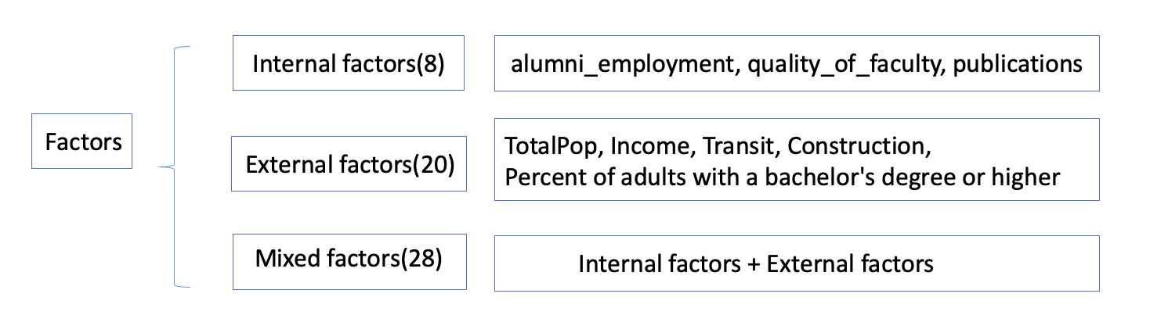
Data sources
Internal:
Rank data
University info
External
Demographic data
Education
Mixed: Combine internal and external

Slide 5
Data Sources
University Ranking Data
University Ranking data were published by The Center for World University Rankings (CWUR) in 2019.
Sources: The Center for World University Rankings (CWUR)
https://www.kaggle.com/mylesoneill/world-university-rankings/download
University Information Data
University Location Data is a dataset that contains locations and university and College.
Sources: Private
Education data
This data contains the education level data from the American Community Survey for adults 25+. Counts are broken down by sex. And there are 5-year estimates shown by tract, county, and state boundaries.
Sources: U.S. Census Bureau’s American Community Survey (ACS) 2016-2020 5-year estimates, Table(s) B15002 https://services.arcgis.com/P3ePLMYs2RVChkJx/arcgis/rest/services/ACS_Educational_Attainment_Boundaries/FeatureServer
Population data
This data provides boundaries for the States of the United States in the 50 states and the District of Columbia. And the attribute fields include estimated 2017 total population. Sources: Esri, TomTom, U.S. Department of Commerce, U.S. Census Bureau https://services.arcgis.com/P3ePLMYs2RVChkJx/arcgis/rest/services/USA_States_Generalized/FeatureServer

Slide 6
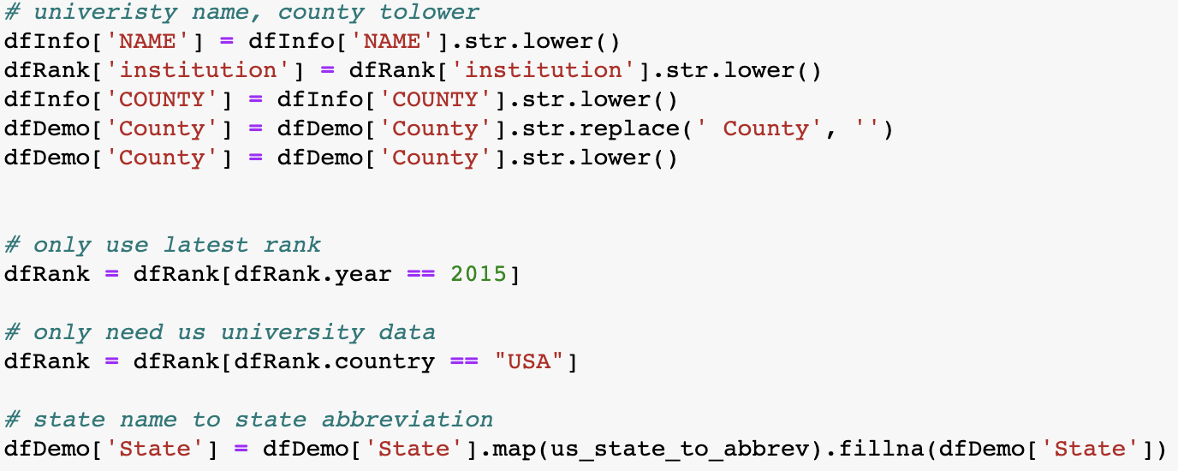
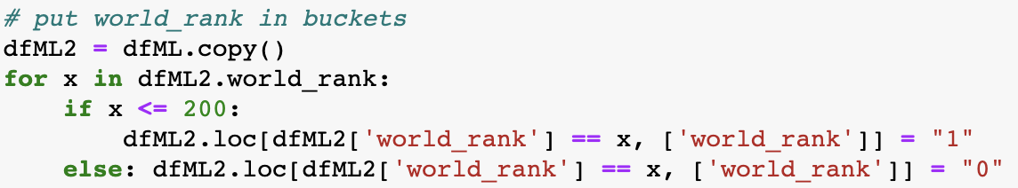
Data Cleaning
Missing value check: none
String revising :
Lower case for string matching
Delete ‘county’
Replace state full name to abbreviation
Filter : use the latest info, only US universities
Binning: put rank data into 2 classes

Slide 7
Data Integration
Merge university info to university rank
Merge education data to demographic data
Merge local demographic data to university rank(county level)

Slide 8
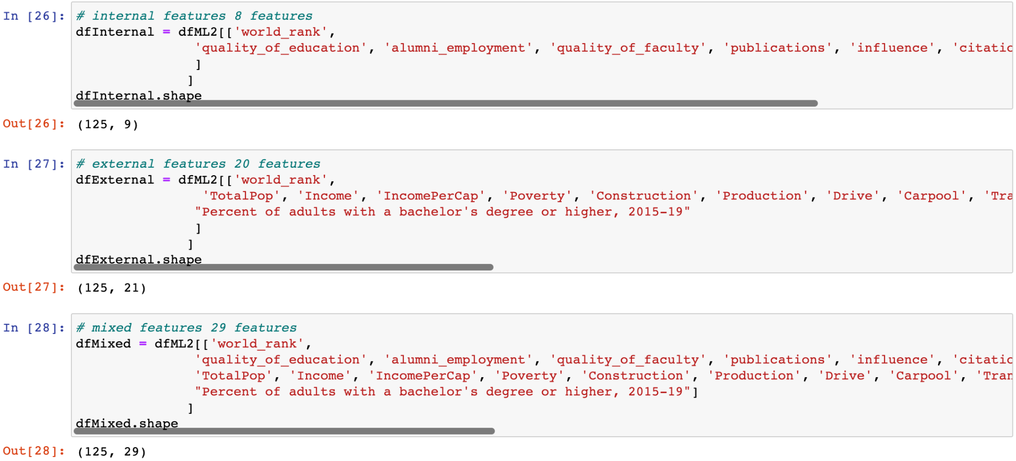
Data Integration
Results:
Manually select internal, external and mixed data

Slide 9
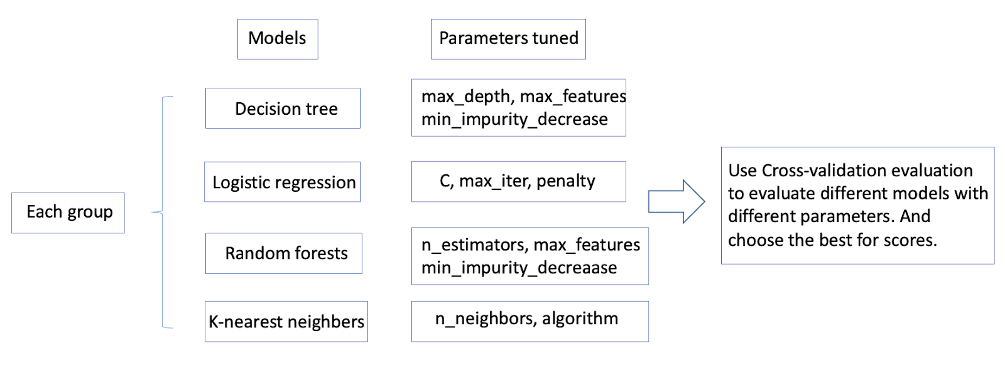
Methodology
Classify features into three groups. (graph1)
Use machine learning such as decision tree, linear regression to perform analysis on the data.
Use cross-validation methods to test and evaluate the models, and choose the best models.
Employ the best models with best parameters and do analysis.

Slide 10
Model details and results
Models used for internal factors
Models used for external factors
Models used for mixed factors
Using cross validation to compare each model
Choose best models and parameters, and do accuracy tests.

Slide 11
Parameter of model for internal factors
Split function internal_train, internal_test = np.split(dfInternal.sample(frac=1, random_state=42),
[int(.8*len(dfInternal))])
Features : 'quality_of_education', 'alumni_employment', 'quality_of_faculty', 'publications', 'influence', 'citations', 'broad_impact', 'patents'
Label : wordrank
Decision tree
cross-validation
Logistic regression
Random forest
knn
Cross-validation result:
best parameters are: DecisionTreeClassifier(min_impurity_decrease=0.01)
accuracy is: 0.93
best parameters are: RandomForestClassifier(min_impurity_decrease=0.01, n_estimators=50)
accuracy is: 0.9400000000000001
best parameters are: Pipeline(steps=[('scale', StandardScaler()),
('model', LogisticRegression(C=0.012328467394420659))])
accuracy is: 0.9400000000000001
best parameters are: KNeighborsClassifier(n_neighbors=3)
accuracy is: 0.93

Slide 12
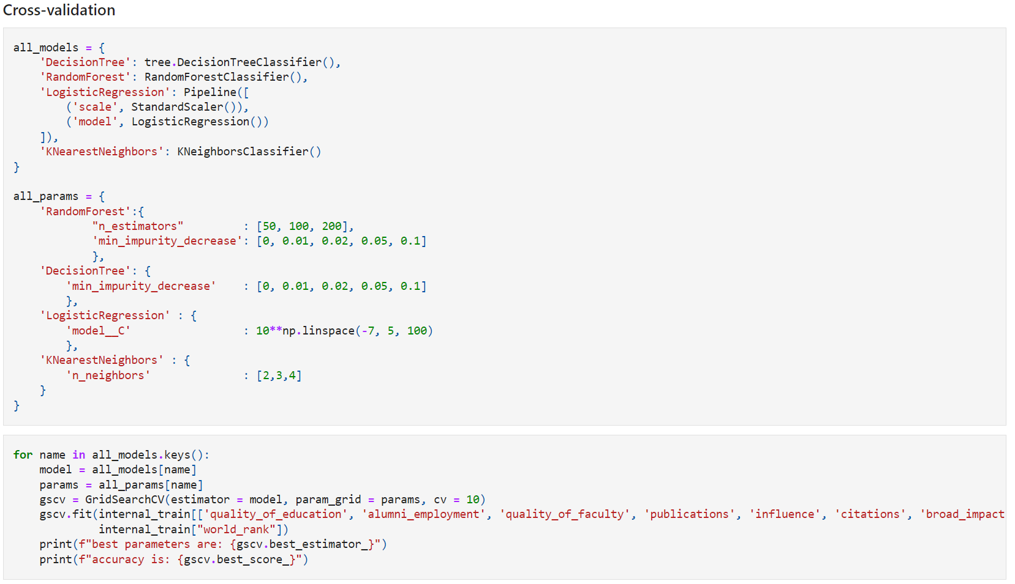
Cross-validation code

Slide 13
Parameter of model for external factors
Split function: external_train, external_test = np.split(dfExternal.sample(frac=1, random_state=42),
[int(.8*len(dfExternal))])
Features: 'TotalPop', 'Income', 'IncomePerCap', 'Poverty', 'Construction', 'Production', 'Drive', 'Carpool', 'Transit', 'Walk', 'OtherTransp', 'WorkAtHome', 'MeanCommute', 'Employed', 'PrivateWork', 'PublicWork', 'SelfEmployed', 'FamilyWork', 'Unemployment',
"Percent of adults with a bachelor's degree or higher, 2015-19"
Label: worldrank
Decision tree
Logistic regression
Knn
Random forest
Cross-validation
Result:
best parameters are: DecisionTreeClassifier(min_impurity_decrease=0)
accuracy is: 0.6199999999999999
best parameters are: RandomForestClassifier(min_impurity_decrease=0.05, n_estimators=50)
accuracy is: 0.65
best parameters are: Pipeline(steps=[('scale', StandardScaler()),
('model', LogisticRegression(C=0.059948425031893966))])
accuracy is: 0.65
best parameters are: KNeighborsClassifier(n_neighbors=2)
accuracy is: 0.6900000000000001

Slide 14
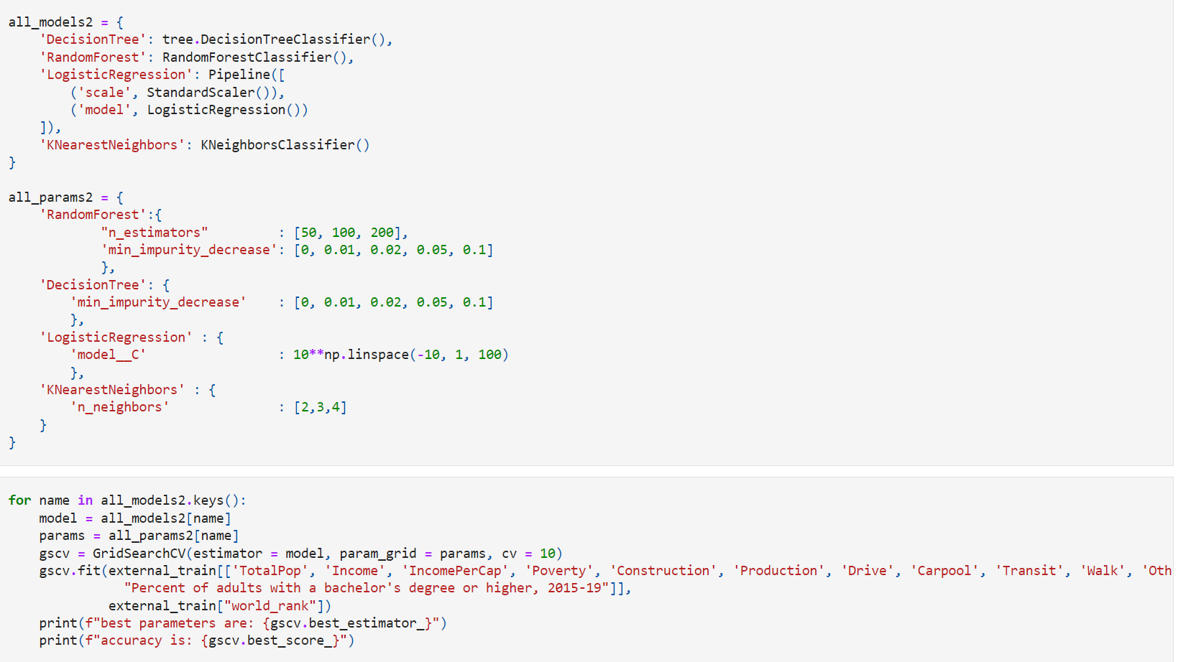
Cross-validation code

Slide 15
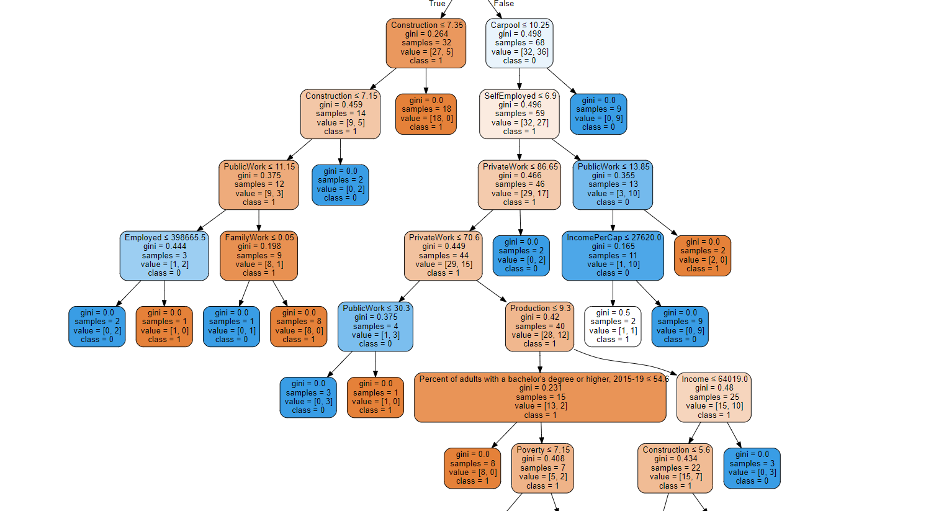
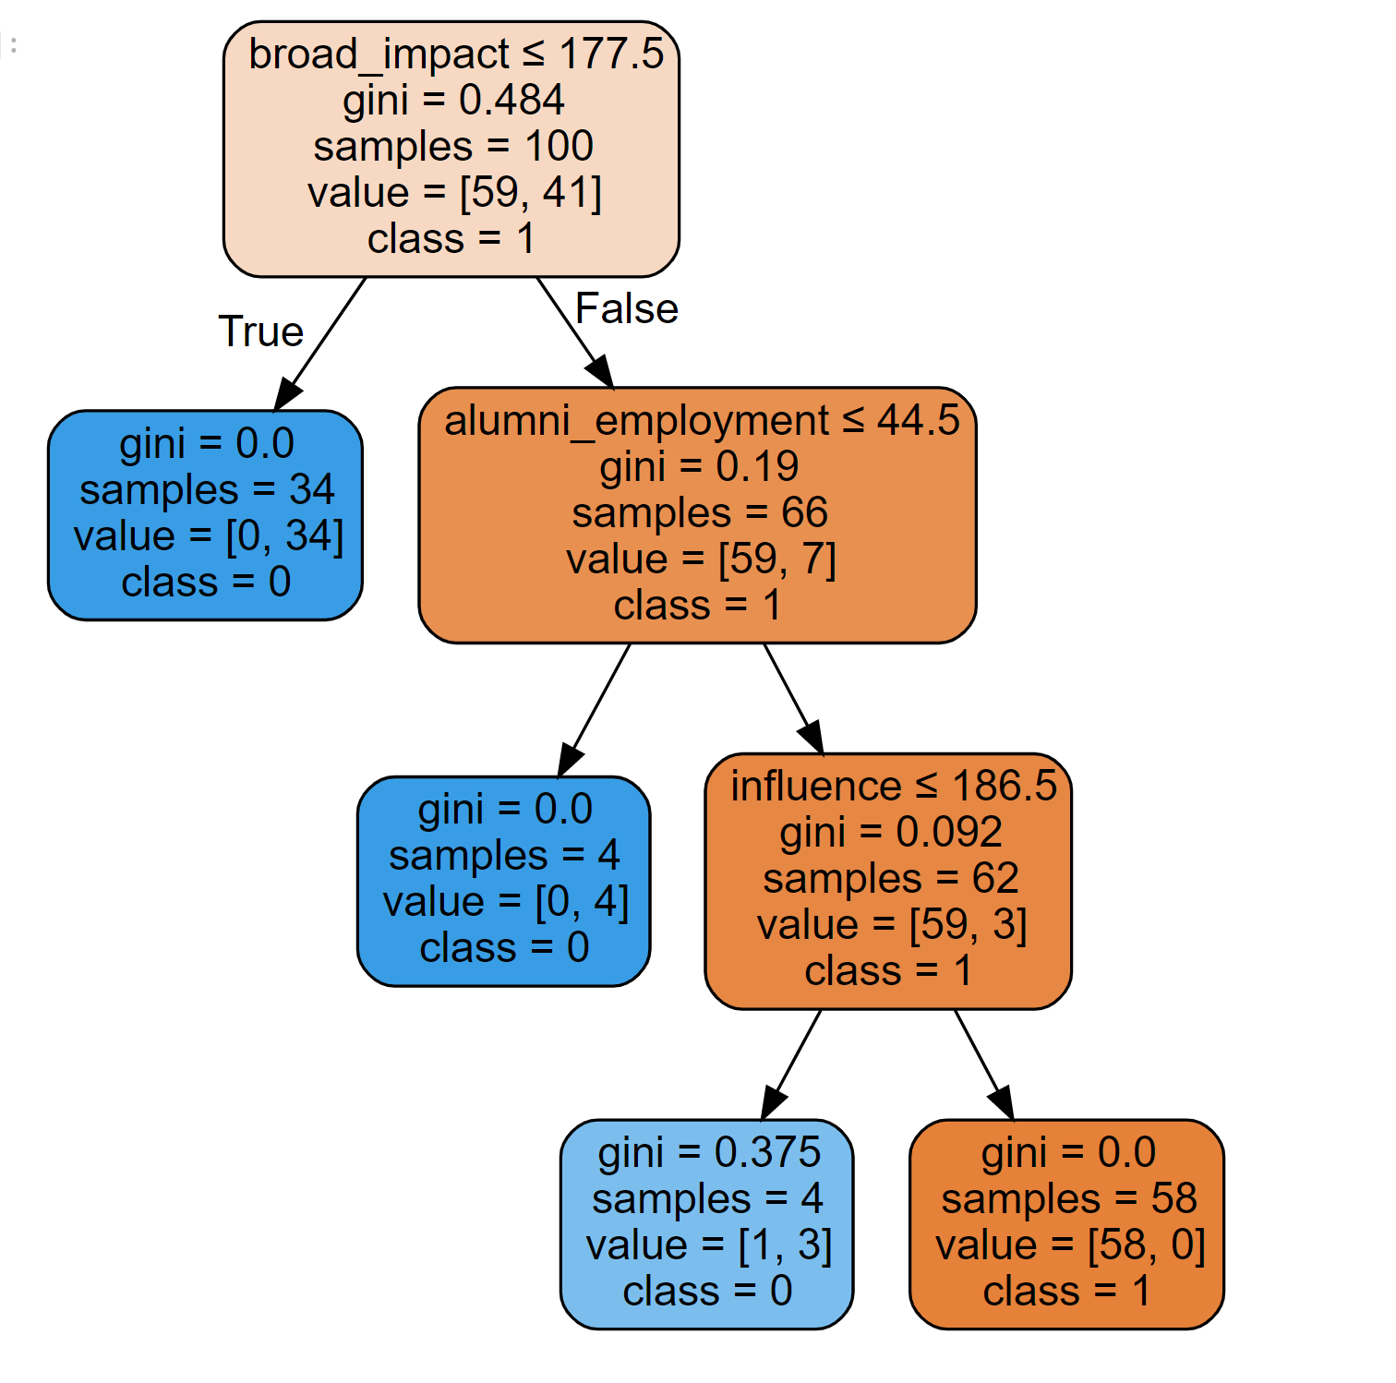
Decision Tree

Slide 16
Parameter of model for mixed factors
Split function: mixed_train, mixed_test = np.split(dfMixed.sample(frac=1, random_state=42),
[int(.8*len(dfMixed))])
features : 'quality_of_education', 'alumni_employment', 'quality_of_faculty', 'publications', 'influence', 'citations', 'broad_impact', 'patents',
'TotalPop', 'Income', 'IncomePerCap', 'Poverty', 'Construction', 'Production', 'Drive', 'Carpool', 'Transit', 'Walk', 'OtherTransp', 'WorkAtHome', 'MeanCommute', 'Employed', 'PrivateWork', 'PublicWork', 'SelfEmployed', 'FamilyWork', 'Unemployment',
"Percent of adults with a bachelor's degree or higher, 2015-19"
Label: worldrank
Decision tree
Knn
Random forest
Logistic regression
Cross-validation
Result:
best parameters are: DecisionTreeClassifier(min_impurity_decrease=0.02)
accuracy is: 0.93
best parameters are: RandomForestClassifier(min_impurity_decrease=0.02, n_estimators=200)
accuracy is: 0.9400000000000001
best parameters are: Pipeline(steps=[('scale', StandardScaler()),
('model', LogisticRegression(C=0.059948425031893966))])
accuracy is: 0.9100000000000001
best parameters are: KNeighborsClassifier(n_neighbors=2)
accuracy is: 0.67

Slide 17
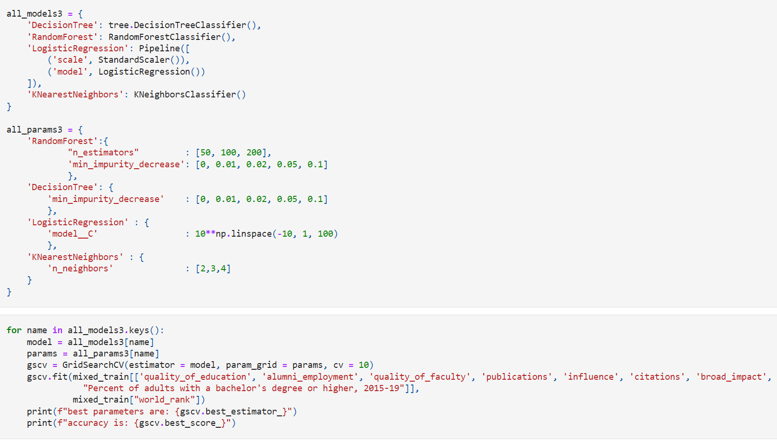
Cross-validation code

Slide 18
Best scores
Highest for Internal: 0.94（random forest）
Highest for External: 0.69(random forest & logistic regression
Highest for Mixed: 0.94(random forest)

Slide 19
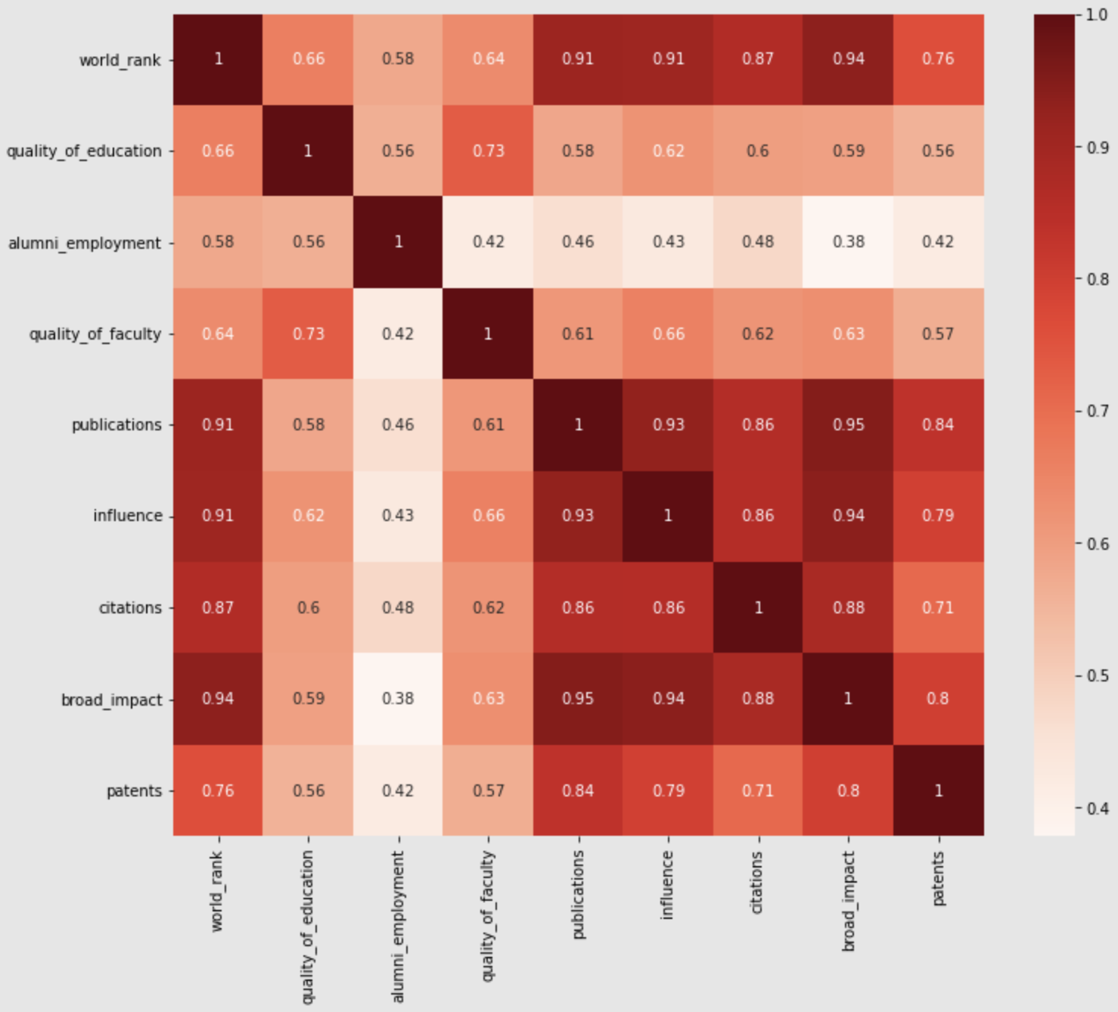
Pearson correlation for internal factors

Slide 20
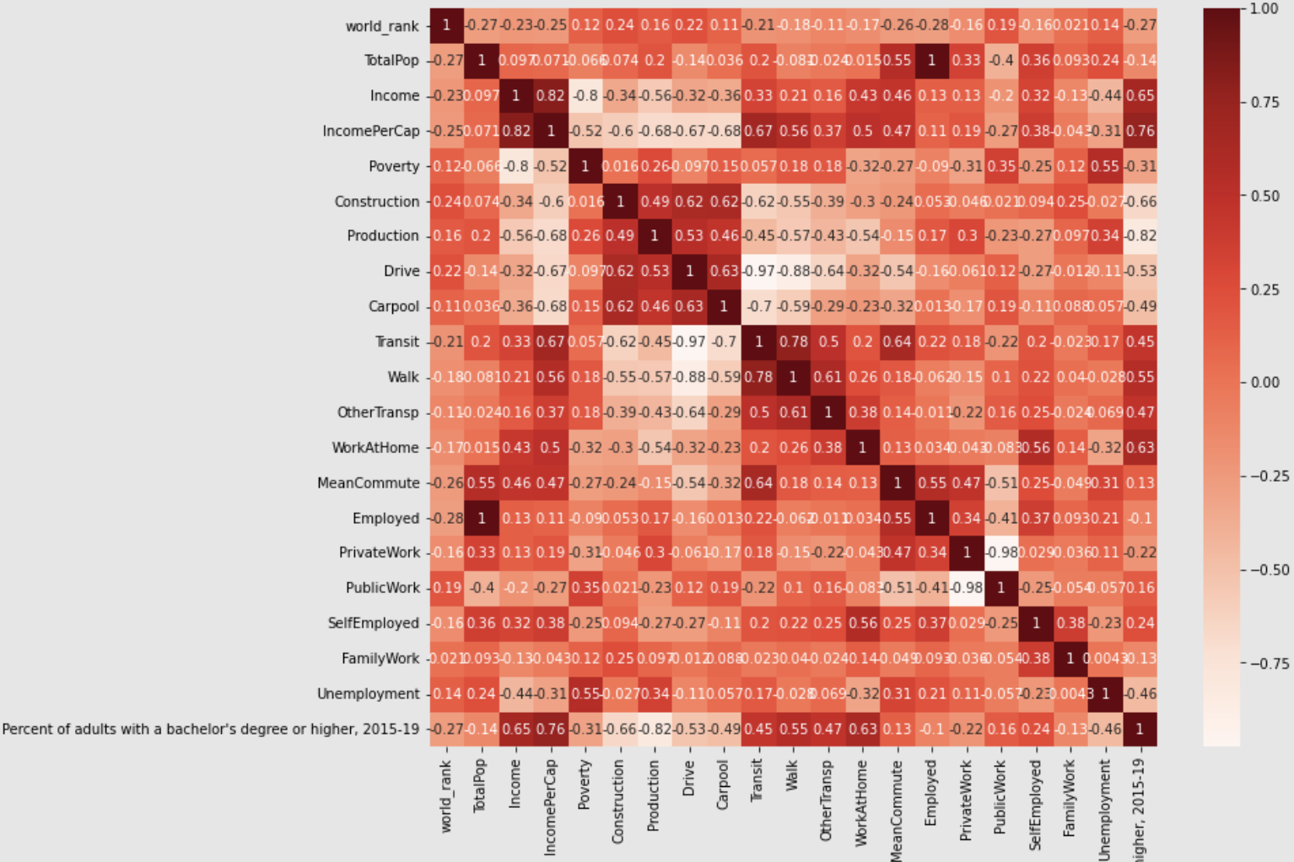
Pearson correlation for External factors

Slide 21
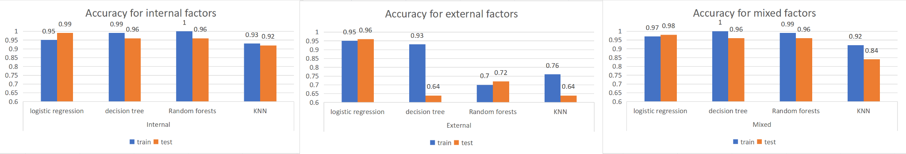
Findings: best group of factors
1.Internal prediction >mixed prediction > better than external

Slide 22
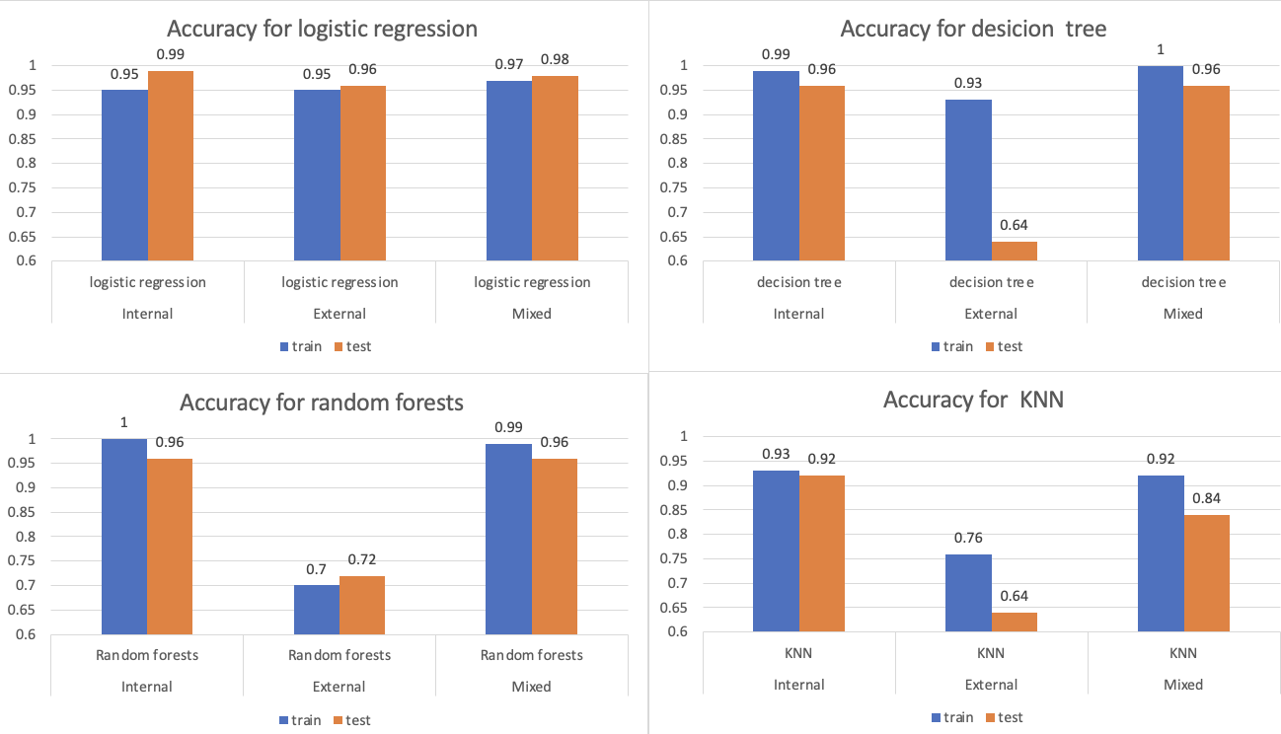
Findings: best model
2. Logistic regression is the best overall

Slide 23
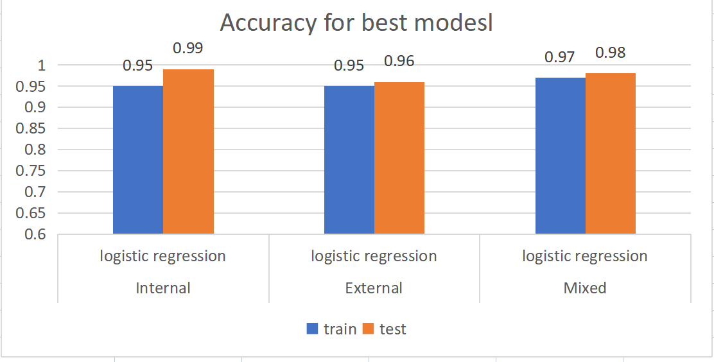
Findings: best results
3. Logistic regression, all over 95% test accuracy

Slide 24
Results
1.internal prediction > mixed prediction > better than external => best indicator or factors for university rank
2. Logistic regression is the best overall
3.Pearson Correlation prove our outcomes.
Correlation: internal features > external features

Slide 25
Limitation
Only use 1 rank data, different rank data may have different results.
Data of internal factors may be different from the real situation. (man-made data, subjective to the people who create the data). For example, quality_of_faculty is an abstract concept which lacks acknowledged standards to evaluate.

Slide 26
Conclusion
Based on the findings, results and limitations we talked about above. We need more data to help us training modules.

Slide 27
Data Source (Reference)
University Ranking Data
University Ranking data were published by The Center for World University Rankings (CWUR) in 2019.
Sources: The Center for World University Rankings (CWUR)
https://www.kaggle.com/mylesoneill/world-university-rankings/download
University Information Data
University Location Data is a dataset that contains locations and university and College.
Sources: Private
Education data
This data contains the education level data from the American Community Survey for adults 25+. Counts are broken down by sex. And there are 5-year estimates shown by tract, county, and state boundaries.
Sources: U.S. Census Bureau’s American Community Survey (ACS) 2016-2020 5-year estimates, Table(s) B15002 https://services.arcgis.com/P3ePLMYs2RVChkJx/arcgis/rest/services/ACS_Educational_Attainment_Boundaries/FeatureServer
Population data
This data provides boundaries for the States of the United States in the 50 states and the District of Columbia. And the attribute fields include estimated 2017 total population. Sources: Esri, TomTom, U.S. Department of Commerce, U.S. Census Bureau https://services.arcgis.com/P3ePLMYs2RVChkJx/arcgis/rest/services/USA_States_Generalized/FeatureServer

Slide 28
Thank you!

